Slide 1

A Platform for Improving Public Resources
Gabriel Barrera, Caleb Christiansen, Aditi Gaur, Bryan Hayes, Jacob Helfman, Sara Kazemi, John Kennon, Amol Modi, Andrew Solomon
Team 225 DefaultGroupName

Slide 2
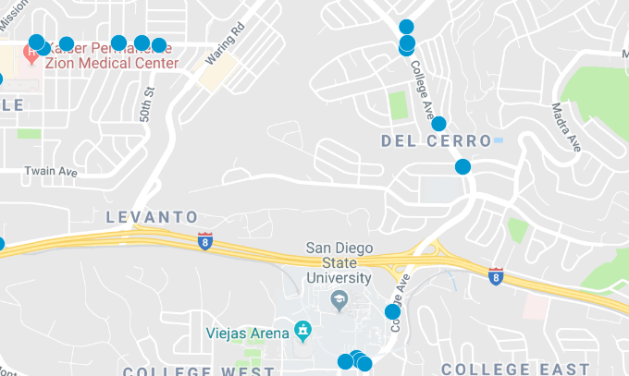
The Problem
“San Diego consistently ranks near the bottom [in the state] when it comes to transit evaluations.”
Voice of San Diego¹

Slide 3
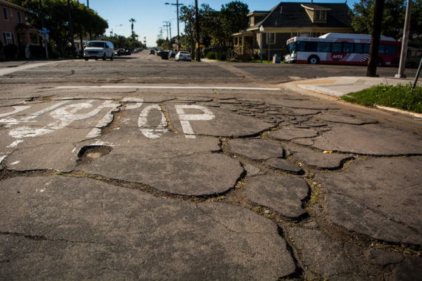
The Problem
“The reality of San Diego is on the public sector side … an increasingly grim and visible civic reality, which is dry rot for public services and infrastructure. That’s still largely hidden.”
Steve Erie, Professor of Political Science at UC San Diego²

Slide 4
Questions
How can we ensure that public transit reaches those who need it?
How can we increase the quality of communication between the public and government agencies?
How can the needs of San Diegans best be met?

Slide 5

The Platform
Interactive Community Action Network

Slide 6
Goals
Quantify the needs of San Diegans
Provide a platform for the voice of the community
Identify new public needs

Slide 7
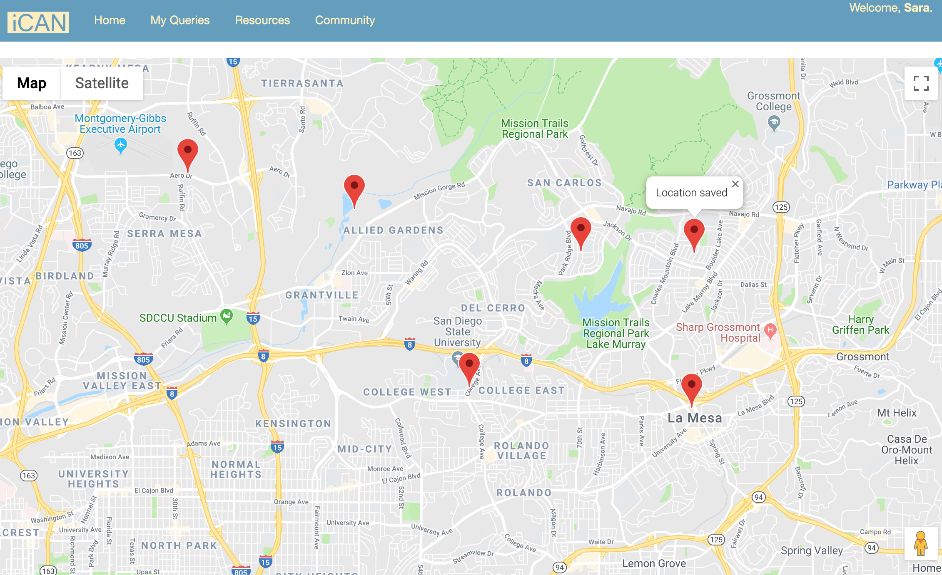
Transit [Live Demo]

Slide 8
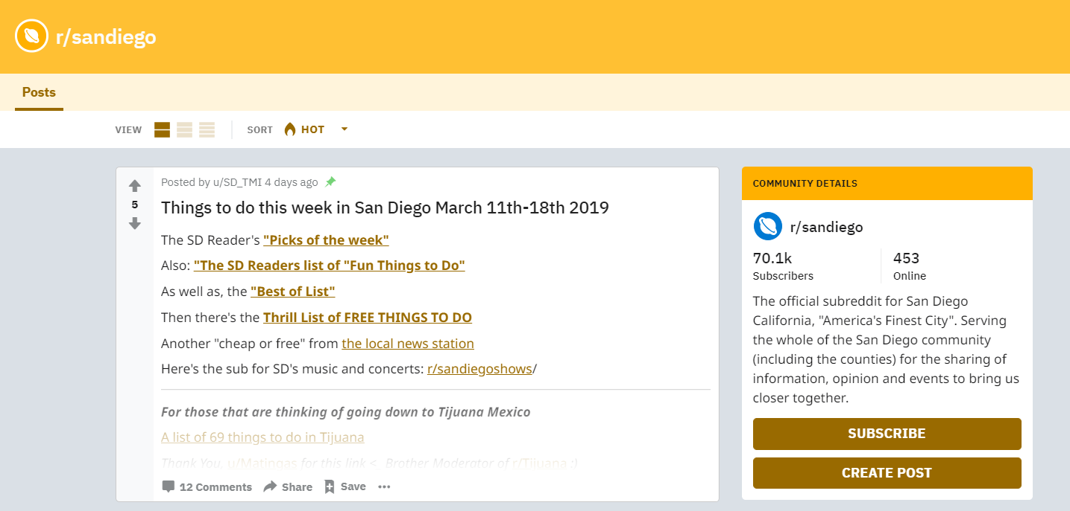
Community

Slide 9
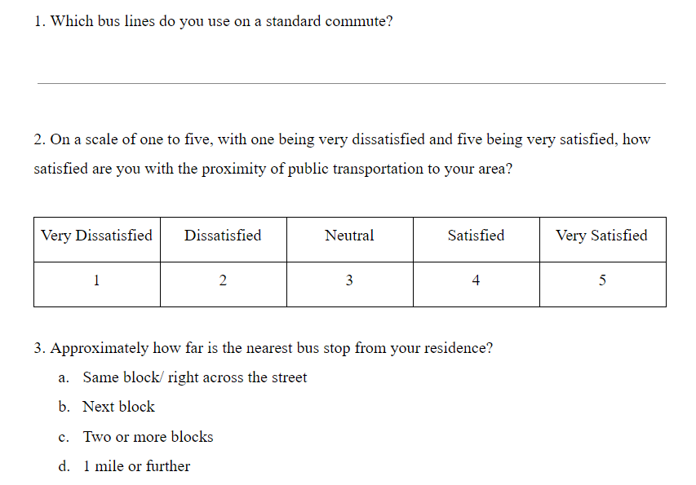
Community

Slide 10

Outcomes
Discover what San Diegans really want
Community engagement
Accountability for elected officials

Slide 11
Sources
¹ San Diego Explained: Improving the Worst Place for Transit Development
https://www.voiceofsandiego.org/topics/land-use/san-diego-explained-improving-the-worst-ranked-transit-system-in-the-state/
² Why San Diegans Are to Blame for the City's Problems
https://www.voiceofsandiego.org/topics/news/why-san-diegans-are-to-blame-for-the-citys-problems/

